Slide 1
The Network, Internet and Web
Copyright © 2014 Pearson Education, Inc. Publishing as Prentice Hall

Slide 2
The Network: Technology Background
Network
  A network is formed when 2 or more computers are linked together.
  Every computer or device on a network can send and receive data from any of the other computers or devices connected to the network.
  A computer which is not part of a network is called a stand-alone computer.
Copyright © 2014 Pearson Education, Inc. Publishing as Prentice Hall
Slide 3-<number>

Slide 3
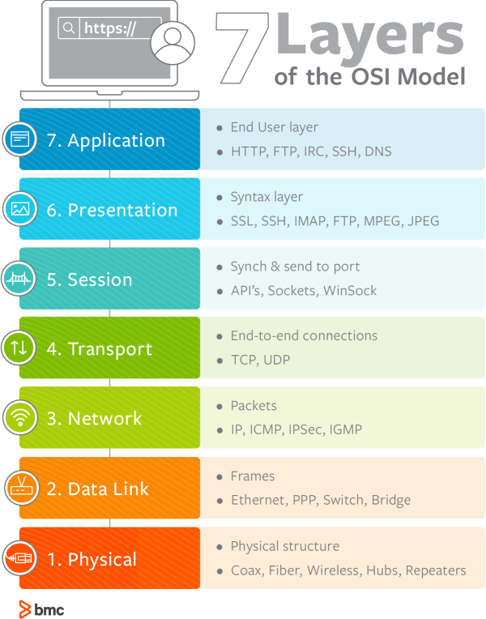
The Network: OSI Model
Copyright © 2014 Pearson Education, Inc. Publishing as Prentice Hall
Slide 3-<number>

Slide 4
The Internet: Technology Background
Internet
  Interconnected network of thousands of networks and millions of computers
  Links businesses, educational institutions, government agencies, and individuals
World Wide Web (Web)
  One of the Internet’s most popular services
  Provides access to billions, possibly trillions, of Web pages
Copyright © 2014 Pearson Education, Inc. Publishing as Prentice Hall
Slide 3-<number>

Slide 5
Evolution of the Internet 1961–Present
Innovation Phase, 1964–1974
  Creation of fundamental building blocks
    Packet switching, TCP/IP, Client-server computing
Institutionalization Phase, 1975–1995
  Large institutions provide funding and legitimization creating ARPANET
Commercialization Phase, 1995–present
  Private corporations take over, expand Internet backbone and local service
Copyright © 2014 Pearson Education, Inc. Publishing as Prentice Hall
Slide 3-<number>

Slide 6
The Internet: Key Technology Concepts
Internet defined as network that:
  Uses IP addressing
  Supports TCP/IP
  Provides services to users, in manner similar to telephone system
Three important concepts:
  Packet switching
  TCP/IP communications protocol
  Client/server computing
Copyright © 2014 Pearson Education, Inc. Publishing as Prentice Hall
Slide 3-<number>

Slide 7
Packet Switching
Slices digital messages into packets
Sends packets along different communication paths as they become available
Reassembles packets once they arrive at destination
Uses routers
  Special purpose computers that interconnect the computer networks that make up the Internet and route packets
  Routing algorithms ensure packets take the best available path toward their destination
Less expensive, wasteful than circuit-switching
Copyright © 2014 Pearson Education, Inc. Publishing as Prentice Hall
Slide 3-<number>

Slide 8
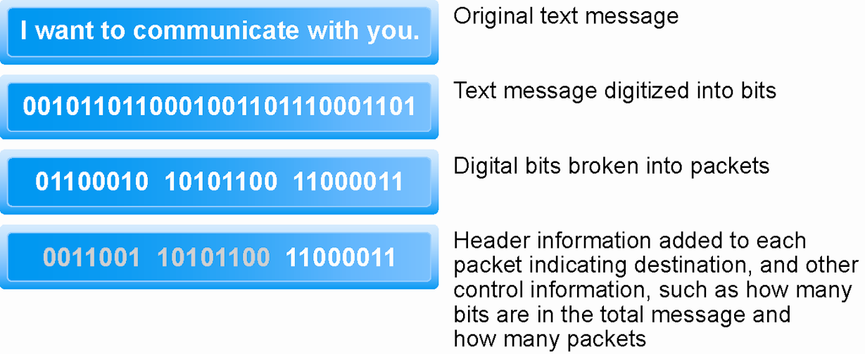
Packet Switching
Figure 3.3, Page 117
Copyright © 2014 Pearson Education, Inc. Publishing as Prentice Hall
Slide 3-<number>

Slide 9
TCP/IP
Transmission Control Protocol (TCP)
  Establishes connections among sending and receiving Web computers
  Handles assembly of packets at point of transmission, and reassembly at receiving end
Internet Protocol (IP)
  Provides the Internet’s addressing scheme to deliver packets
Four TCP/IP architecture layers
  Network interface or link layer responsible for sending and receiving packets
  Internet layer responsible for addressing and routing
  Transport layer handles host-to-host communication
  Application layer provides an array of applications to users such as HTTP, FTP, SMTP.
Copyright © 2014 Pearson Education, Inc. Publishing as Prentice Hall
Slide 3-<number>

Slide 10
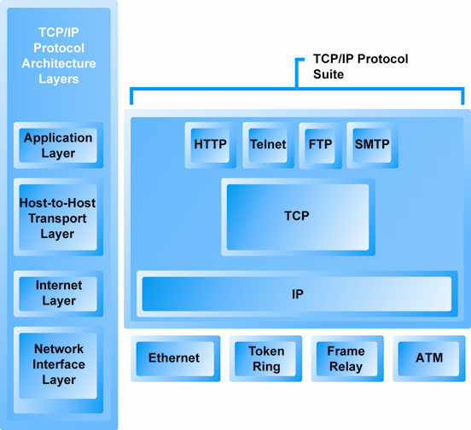
The TCP/IP Architecture and Protocol Suite
Figure 3.4, Page 119
Copyright © 2014 Pearson Education, Inc. Publishing as Prentice Hall
Slide 3-<number>

Slide 11
Internet (IP) Addresses
IPv4
  32-bit number
  Four sets of numbers marked off by periods: 201.61.186.227 or 220.216.178.6
    Class C address: Network identified by first three sets, computer identified by last set
IPv6
  128-bit addresses, able to handle up to 1 quadrillion addresses (IPv4 can handle only 4 billion)
Copyright © 2014 Pearson Education, Inc. Publishing as Prentice Hall
Slide 3-<number>

Slide 12
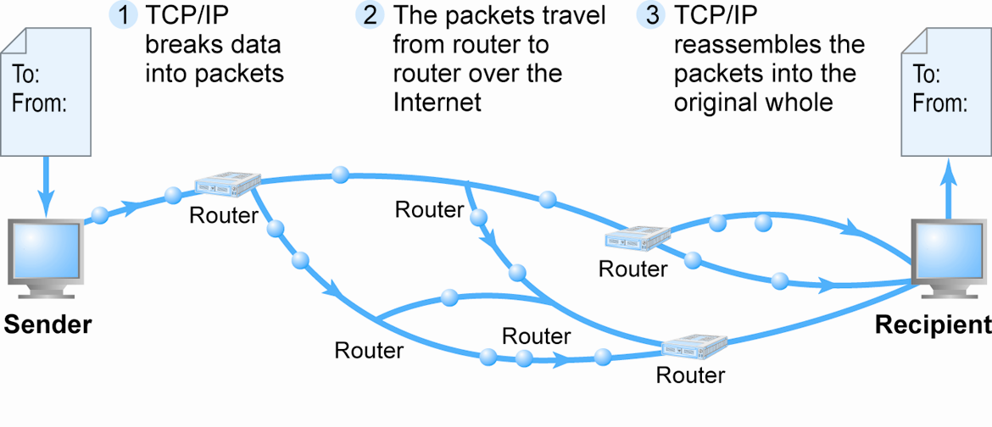
Routing Internet Messages: TCP/IP and Packet Switching
Figure 3.5, Page 120
Copyright © 2014 Pearson Education, Inc. Publishing as Prentice Hall
Slide 3-<number>

Slide 13
Domain Names, DNS, and URLs
Domain name (.edu, .com, .org etc) (See figure)
  IP address expressed in natural language
Domain name system (DNS)
  Allows numeric IP addresses to be expressed in natural language
Uniform resource locator (URL)
  Address used by Web browser to identify location of content on the Web
  For example: http://www.azimuth-interactive.com/flash_test
Copyright © 2014 Pearson Education, Inc. Publishing as Prentice Hall
Slide 3-<number>

Slide 14
Client/Server Computing
Powerful personal computers (clients) connected in network with one or more servers
Servers perform common functions for the clients
  Storing files
  Software applications
  Access to printers, and other peripherals
Copyright © 2014 Pearson Education, Inc. Publishing as Prentice Hall
Slide 3-<number>

Slide 15
Other Internet Protocols and Utility Programs
Internet protocols
  HTTP
  E-mail: SMTP (Simple Mail Transfer Protocol), POP3 (Post Office Protocol 3), IMAP (Internet Message Access Protocol) alternative to POP
  FTP, Telnet, SSL (Secure Sockets Layer)/TLS (Transport Layer Security) newer alternative to SSL
Utility programs
  Ping
  Tracert is one of several route/path tracing utilities
Copyright © 2014 Pearson Education, Inc. Publishing as Prentice Hall
Slide 3-<number>

Slide 16
Internet Service Providers (ISPs)
Provide lowest level of service to individuals, small businesses, some institutions
Types of service
  Narrowband (dial-up)
  Broadband
    Digital Subscriber Line (DSL)
    Cable modem
    T1 and T3
    Satellite
Copyright © 2014 Pearson Education, Inc. Publishing as Prentice Hall
Slide 3-<number>

Slide 17
Intranets
Intranet
  TCP/IP network located within a single organization for communications and processing
  Used by private and government organizations for internal networks
  All Internet applications can be used in private intranets
Copyright © 2014 Pearson Education, Inc. Publishing as Prentice Hall
Slide 3-<number>

Slide 18
Extranet
Extranet
  An extranet is a private network that enterprises use to provide trusted third parties -- such as suppliers, vendors, partners, customers and other businesses -- secure, controlled access to business information or operations.
Copyright © 2014 Pearson Education, Inc. Publishing as Prentice Hall
Slide 3-<number>

Slide 19
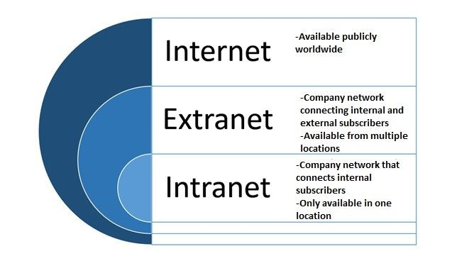
Internet vs Extranet vs Intranet
Copyright © 2014 Pearson Education, Inc. Publishing as Prentice Hall
Slide 3-<number>

Slide 20
Who Governs the Internet?
Organizations that influence the Internet and monitor its operations include:
  Internet Corporation for Assigned Names and Numbers (ICANN)
  Internet Assigned Numbers Authority (IANA)
  Internet Engineering Task Force (IETF)
  Internet Research Task Force (IRTF)
  Internet Engineering Steering Group (IESG)
  Internet Architecture Board (IAB)
  Internet Society (ISOC)
  Internet Governance Forum (IGF)
  World Wide Web Consortium (W3C)
  Internet Network Operators Groups (NOGs)
Copyright © 2014 Pearson Education, Inc. Publishing as Prentice Hall
Slide 3-<number>

Slide 21
Limitations of the Current Internet
Bandwidth limitations
  Slow peak-hour service
Quality of service limitations
  Latency – delays due to uneven flow of info packets
Network architecture limitations
  Identical requests are processed individually (i.e.. Downloading a music track)
Wired Internet
  Copper and expensive fiber-optic cables
Copyright © 2014 Pearson Education, Inc. Publishing as Prentice Hall
Slide 3-<number>

Slide 22
Wireless Internet Access
Network Technologies
Wi-Fi (Wireless Fidelity)
  High-speed, fixed broadband wireless LAN (WLAN)
  Wireless access point (“hot spots”)
  Limited range but inexpensive
  For-profit Wi-Fi networks: Boingo, AT&T Wi-Fi Services
WiMax (Worldwide Interoperability for Microwave Access)
  High-speed, medium range broadband wireless metropolitan area network (e.g., Baltimore, Portland, Houston, Atlanta)
Bluetooth
  Personal connectivity between devices and to Internet
  Low-speed, short range connection
Copyright © 2014 Pearson Education, Inc. Publishing as Prentice Hall
Slide 3-<number>

Slide 23
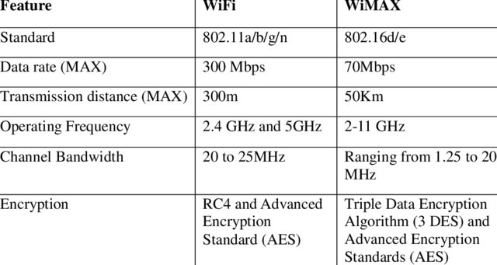
Difference between WiFi and WiMAX
Copyright © 2014 Pearson Education, Inc. Publishing as Prentice Hall
Slide 3-<number>

Slide 24
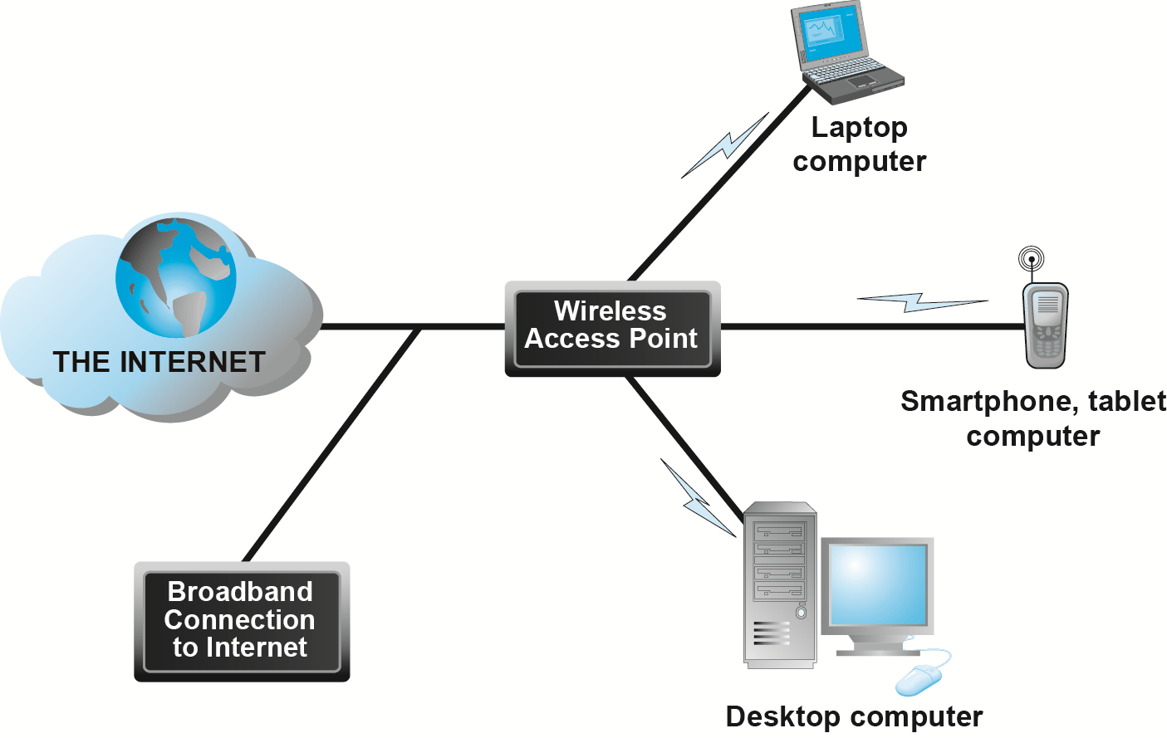
Wi-Fi Networks
Figure 3.15, Page 145
Copyright © 2014 Pearson Education, Inc. Publishing as Prentice Hall
Slide 3-<number>

Slide 25
Hypertext
Text formatted with embedded links
  Links connect documents to one another, and to other objects such as sound, video, or animation files
Uses Hypertext Transfer Protocol (HTTP) and URLs to locate resources on the Web
  Example URL: http://megacorp.com/content/features/082602.html
Copyright © 2014 Pearson Education, Inc. Publishing as Prentice Hall
Slide 3-<number>

Slide 26
Markup Languages
Hypertext Markup Language (HTML)
  Fixed set of pre-defined markup “tags” used to format text
  Controls look and feel of Web pages
  HTML5 the newest version
eXtensible Markup Language (XML)
  Designed to describe data and information
  Tags used are defined by user
Copyright © 2014 Pearson Education, Inc. Publishing as Prentice Hall
Slide 3-<number>

Slide 27
Web Servers and Web Clients
Web server software
  Enables a computer to deliver Web pages to clients on a network that request this service by sending an HTTP request
  Apache, Microsoft IIS
  Basic capabilities: Security services, FTP, search engine capabilities, data capture (e.g. using bar code reader)
Web server
  May refer to either Web server software or physical server
  Specialized servers: Database servers, ad servers, and so on
Web client
  Any computing device attached to the Internet that is capable of making HTTP requests and displaying HTML pages
Copyright © 2014 Pearson Education, Inc. Publishing as Prentice Hall
Slide 3-<number>

Slide 28
Web Browsers
Primary purpose to display Web pages
Internet Explorer—54% of market
Mozilla Firefox—20%
  Open source
Other browsers
  Google Chrome—19%
  Apple’s Safari—5%
Copyright © 2014 Pearson Education, Inc. Publishing as Prentice Hall
Slide 3-<number>

Slide 29
Search Engines
Identify Web pages that match queries based on one or more techniques
  Keyword indexes, page ranking
Also serve as:
  Shopping tools
  Advertising vehicles (search engine marketing)
  Tool within e-commerce sites
Outside of e-mail, most commonly used Internet activity
Copyright © 2014 Pearson Education, Inc. Publishing as Prentice Hall
Slide 3-<number>

Slide 30
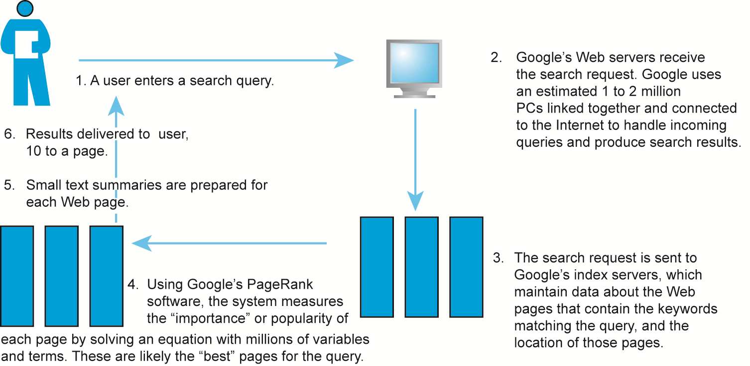
How Google Works
Figure 3.20, Page 161
Copyright © 2014 Pearson Education, Inc. Publishing as Prentice Hall
Slide 3-<number>

Slide 31
Online Forums and Chat
Online forum
  Also known as a message board, bulletin board, discussion board, discussion group, board, or forum
  Web application that enables Internet users to communicate with one another, although not in real time
  Members visit online forum to check for new posts
Online chat
  Similar to IM, but for multiple users
  Typically, users log into chat room
Copyright © 2014 Pearson Education, Inc. Publishing as Prentice Hall
Slide 3-<number>

Slide 32
Streaming Media
Enables music, video, and other large files to be sent to users in chunks so that when received and played, file comes through uninterrupted
Allows users to begin playing media files before file is fully downloaded
Copyright © 2014 Pearson Education, Inc. Publishing as Prentice Hall
Slide 3-<number>

Slide 33
Cookies
Small text files deposited by Web site on user’s computer to store information about user, accessed when user next visits Web site
Can help personalize Web site experience
Can pose privacy threat
Copyright © 2014 Pearson Education, Inc. Publishing as Prentice Hall
Slide 3-<number>

Slide 34
That’s All for Today
Copyright © 2014 Pearson Education, Inc. Publishing as Prentice Hall
Slide 2-<number>

